Slide 1

Kroger Take Home Assessment
Hrishikesh Anil Patil
Data Analytics Engineer

Slide 2
Project Overview
My Approach to Kroger’s Produce Table Allocation
“I began this assessment to figure out how best to arrange produce across five 14×14-foot tables. My main goal was to boost sales while reducing waste, and I focused on combining item popularity with physical space constraints.”

Slide 3
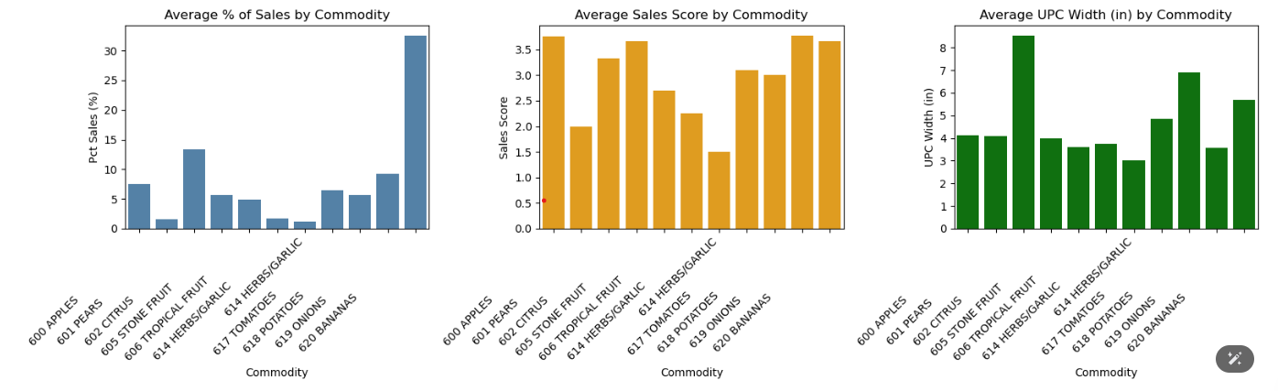
Data & Key Insights
I combined two data files: one detailing sales scores and recent sales percentages, and another covering item sizes and UPC descriptions. Through quick exploratory analysis (EDA), I discovered that Bananas, Apples, Citrus, and Onions are strong revenue drivers, while some items like Pears and Herbs/Garlic have lower sales scores. I also found that certain items have wider footprints (4–8 inches), which impacts table capacity.

Slide 4
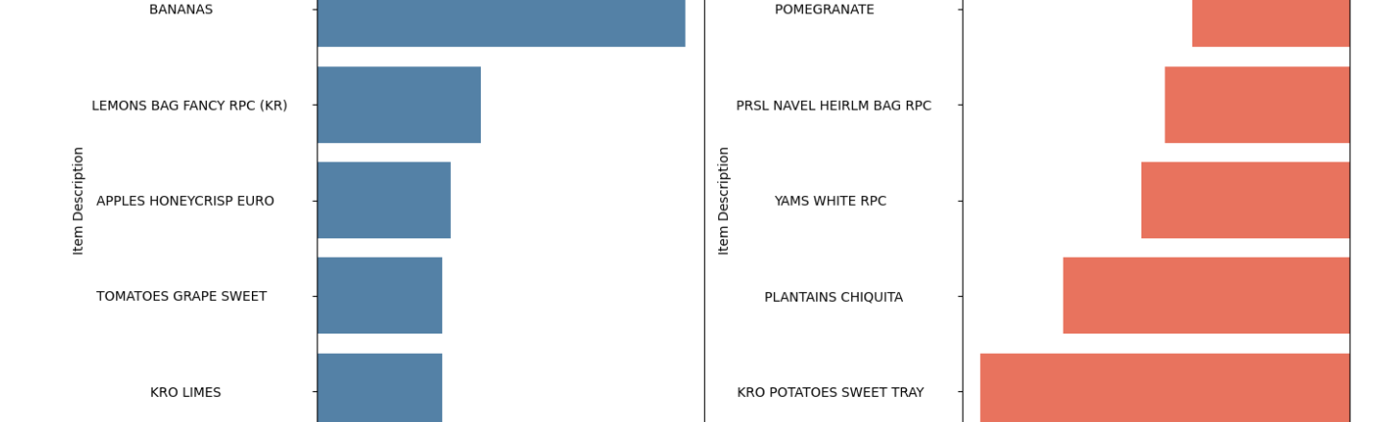
My Ranking Metric
Next, I created a simple ‘combined metric’ to rank items by both sales performance (Pct Sales × Sales Score) and size penalty. By slightly penalizing large items, I could ensure that high-sales, moderate-width produce topped the list. Bananas unsurprisingly ranked first with a big lead makes sense given their popularity.

Slide 5
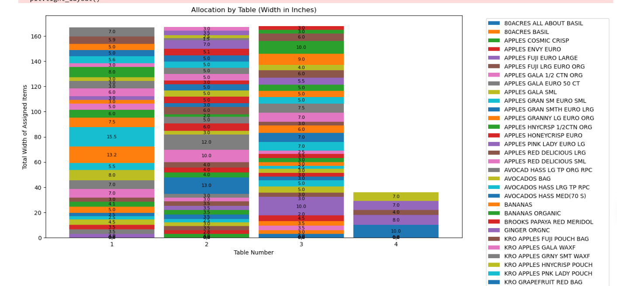
Allocation Logic & Results
I then assigned items to tables based on their combined metric, ensuring each table had enough width capacity (168 inches). My approach started with the highest-ranked item and filled tables one by one, leaving some tables fuller than others. This kept me within space limits and gave prime real estate to the top sellers

Slide 6
Recommendations & Next Steps
“I recommend prioritizing Bananas, Apples, and Citrus on prominent tables because of their high revenue impact. Smaller, lower-selling items can fill remaining space or be placed strategically for variety.
If we need a more even distribution—say, Bananas on multiple tables—I'd tweak my logic to place a high-demand item on more than one surface.
This data-driven approach should keep the produce area both profitable and appealing to customers as well as reduce the waste or skrinage.”

Slide 7

Thank You

